Slide 1
The Structure of an Atom

Slide 2
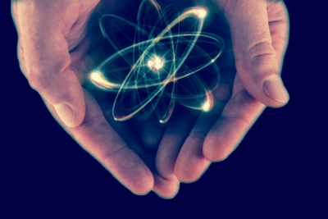
After you have completed this lesson, you should be able to:
Describe the structure of an atom in terms of the subatomic particles: protons, neutrons and electrons.
Identify and draw the location of these subatomic particles within a model of an atom.
State the charges on each subatomic particle, and explain how these contribute to the overall charge on an atom.

Slide 3
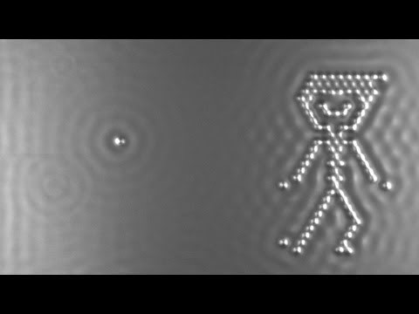
Atoms are the smallest particles of a substance that can exist while still possessing all the unique chemical properties of that substance.
Atoms can only be seen with an incredibly powerful microscope, and they look like tiny spheres, as you can see in the video below.

Slide 4
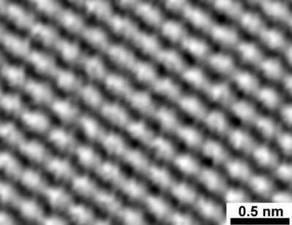
Atoms are commonly described as the building blocks of all matter.
They make up everything in the universe and are the basis of chemistry.
Atoms are so tiny that they cannot be seen except with a powerful microscope called a scanning tunnelling microscope (STM). They can be thought of as tiny spheres.

Slide 5
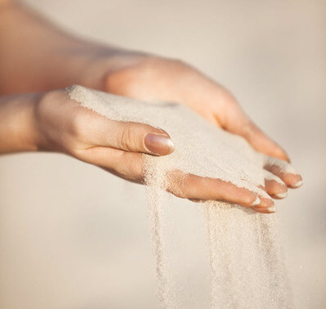
Just how small are atoms?
The size of atoms is often measured in ångströms (Å), where 1 ångström is equal to 1×10⁻¹⁰ m. The diameter of a hydrogen atom is approximately 1A˚, and the diameter of a uranium atom, the largest naturally occurring element, is approximately 5A˚.
A single grain of sand contains about 22 quintillion (22,000,000,000,000,000,000) atoms. That's a lot!

Slide 6
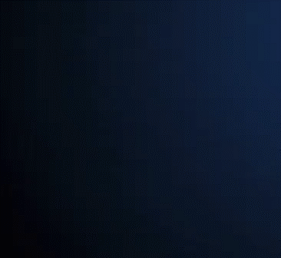
An atom is the smallest part of a substance that can exist and still possess all the unique chemical properties of that substance. This is why they're called the building blocks of matter.
You might already know that atoms are actually made up of even smaller particles called protons, neutrons, and electrons. Different types of atoms have different numbers of protons, neutrons, and electrons.
However, protons, neutrons, and electrons on their own do not possess the chemical properties of elements. It is only when they are in combination that substances with different properties are formed.

Slide 7
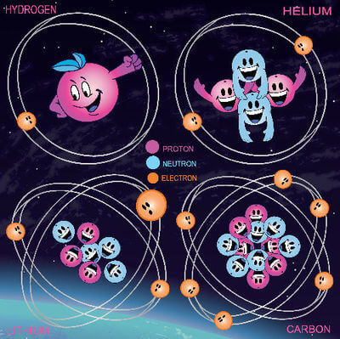
Different types of atoms have different numbers of protons, neutrons and electrons.
These different types of atoms are called elements. The term element also describes a substance made up of just one type of atom.
There are currently 118 known elements. They can be organised based on their properties into a chart called the periodic table. The periodic table gives you information about each element and the atoms that make it up.

Slide 8
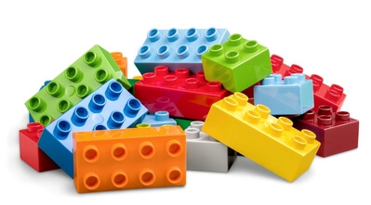
You can think of atoms as being like pieces of Lego: each different arrangement of atoms creates something new.
For example, your body is made up of 26 types of atom arranged in many different ways to form your blood, skin, hair, muscles, and so on. In fact, 96% of your body is made up of just four types: carbon, oxygen, hydrogen, and nitrogen atoms.

Slide 9
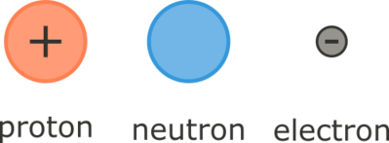
Atoms are so small that they cannot be seen without an extremely powerful microscope. But atoms are actually made up of even smaller particles called subatomic particles ("smaller than an atom" particles). These are the protons, neutrons, and electrons.

Slide 10
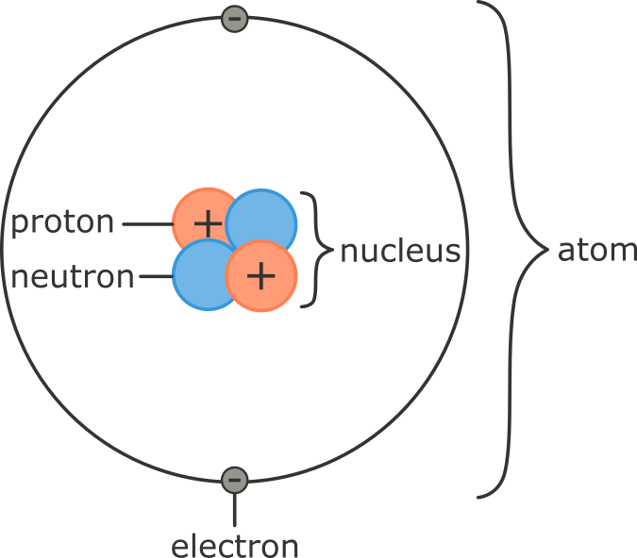
Protons and neutrons make up the nucleus, which is at the centre of the atom (nucleus means centre or core).
Electrons are found in orbitals (or shells) around the outside of the nucleus.

Slide 11
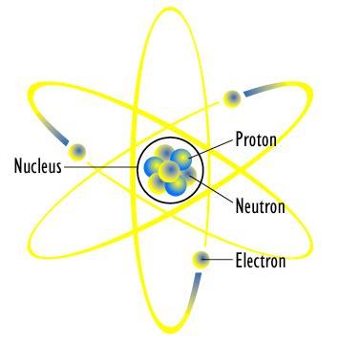
Protons are positively charged (+1); electrons are negatively charged (−1); and neutrons are neutral (have no charge; 0).
Protons and electrons have opposite charges to each other. Electrons are constantly moving in their shells outside the nucleus. The attraction between the electrons and protons holds the electrons in their shells.
Atoms have equal numbers of positively charged protons and negatively charged electrons, making them neutral (uncharged) overall.

Slide 12
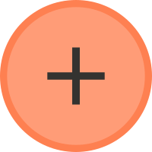

It is also important to look at the size of the subatomic particles. Most of an atom's mass (about 99.9%) is made up of the protons and neutrons.
Protons and neutrons each have a mass of 1.67×10⁻²⁴ g. This is such a tiny number that a new unit of mass is used: the atomic mass unit (amu).
Using these units, protons and neutrons both have a mass of 1 amu.

Slide 13
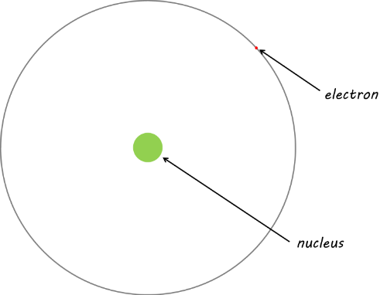
Electrons are 1840 times smaller than protons and neutrons, with a mass of 0.000549 amu. Their mass is usually represented in terms of the relative mass, i.e. 1/1840 of the mass of protons and neutrons.

Slide 14

Electrons are also found a very long way from the nucleus, which means that most of an atom is empty space.
If the nucleus of a hydrogen atom were the size of a golf ball, the electron would be the width of a human hair and be found at a distance similar to the height of the Sky Tower!

Slide 15
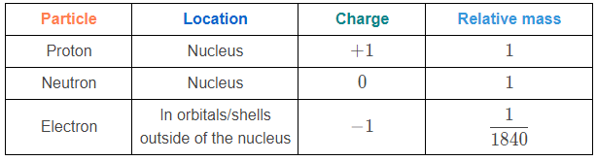
This table summarises the information you need to know about the subatomic particles:

